Slide 1

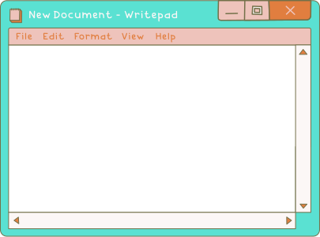


EDUCATION PRESENTATION
HISTORY OF THE
INTERNET

Slide 2

HOW TO USE THIS PRESENTATION
GOOGLE SLIDES
POWERPOINT
CANVA
Click on the "Google Slides" button below this presentation preview. Make sure to sign in to your Google account. Click on "Make a copy." Start editing your presentation.
Alternative: Click on the "Share" button on the top right corner
in Canva and click on "More" at
the bottom of the menu. Enter "Google Drive" in the search bar and click on the GDrive icon to
add this design as a Google
slide in your GDrive.
Click on the "PowerPoint" button below this presentation preview. Start editing your presentation.
Alternative: From Canva template file, Click on the "Share" button on the top right corner in Canva and click on "More" at the bottom of the menu. Enter "PowerPoint" in the search bar and click on the PowerPoint icon to download.
Click on the "Canva" button under this presentation preview. Start editing your presentation. You need to sign in to your Canva account.

Slide 3
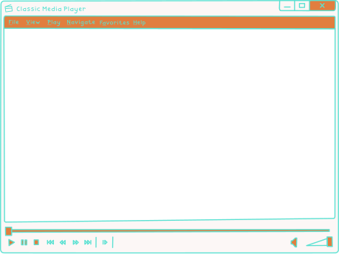

01.
The internet is the global
system of interconnected
computer networks that use the Internet protocol suite to link billions of devices worldwide.
THE INTERNET

Slide 4
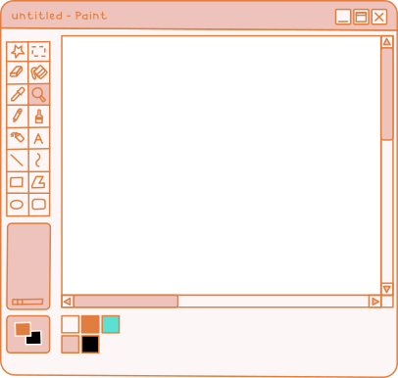

IN THE
The history of the Internet begins with the development of electronic computers in the 1950s. Initial concepts of packet networking originated in several computer science laboratories in the United States, United Kingdom, and France.
1950s

Slide 5
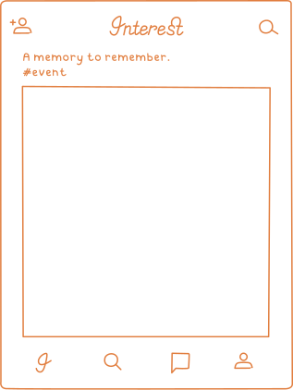
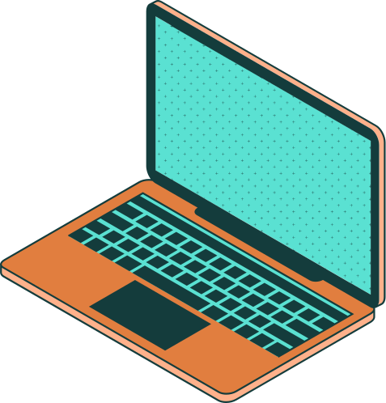
DONALD DAVIES
PACKET-SWITCH NETWORK DESIGNER
The first message was sent over the ARPANET from computer science
Professor Leonard Kleinrock's laboratory at University of California, Los Angeles (UCLA) to the second network node at Stanford Research Institute.
1971

Slide 6

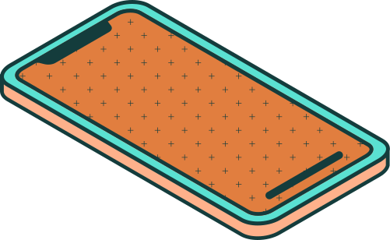
"THE INTERNET
is becoming the town
square for the global
village of tomorrow."
- BILL GATES

Slide 7

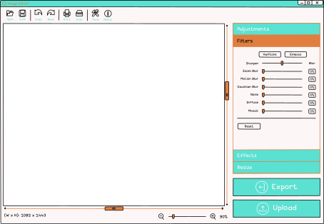

The ARPANET project led to the development of protocols for internetworking, in which multiple separate networks could be joined into a network of networks
INTERNETWORKING
1968-1972

Slide 8
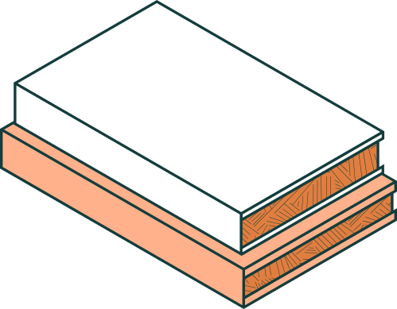

98%
of internet users say
they would not be able to live without it today
3,239
hours a month is spent online, for the average internet user
9/10
people connect to the internet everyday

Slide 9

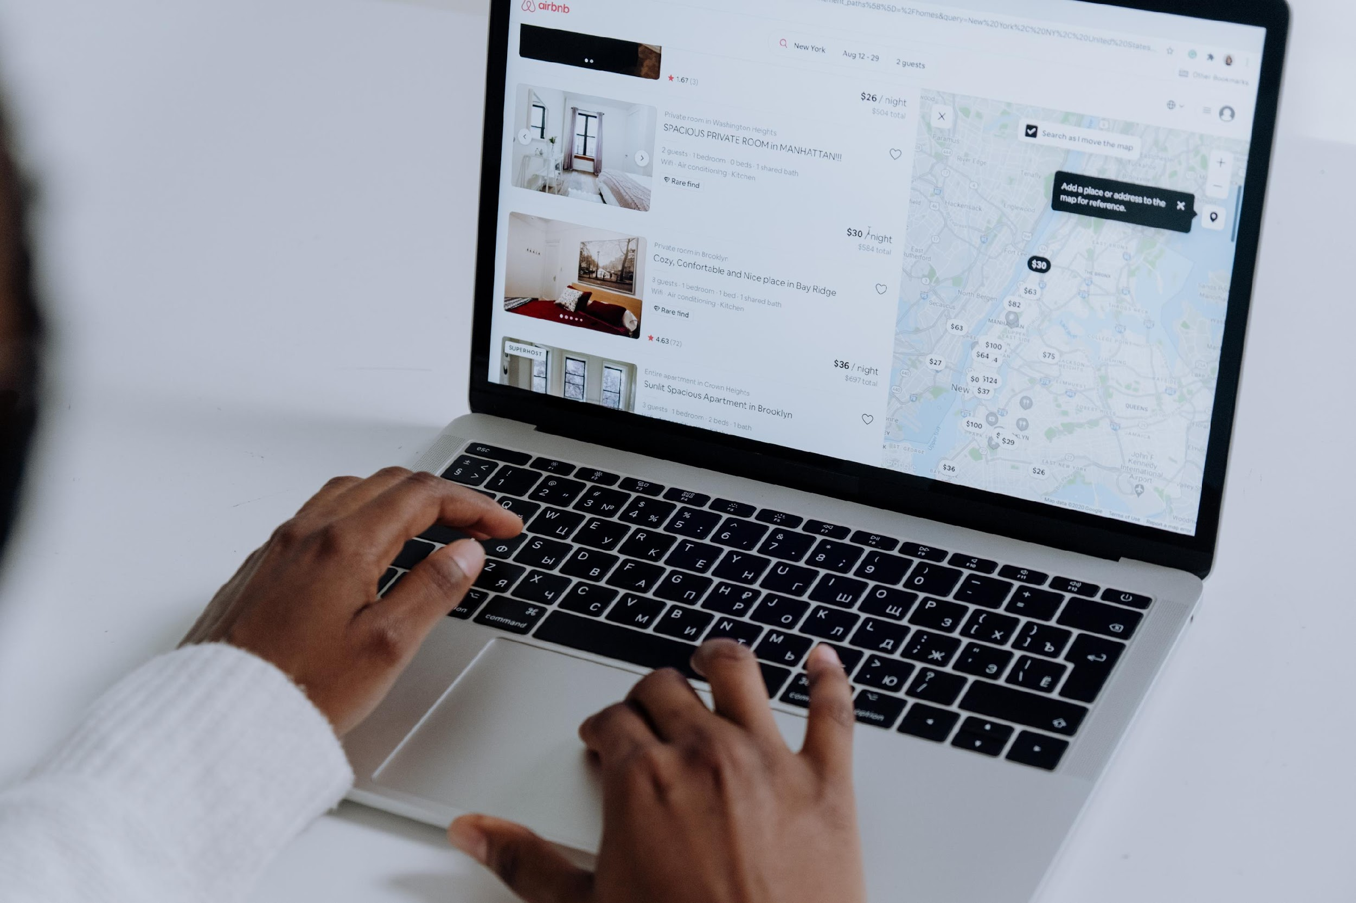


A picture is worth a thousand words

Slide 10

THE BIRTH OF THE
World Wide web
1980s
Research at CERN in Switzerland by Tim Berners-Lee resulted in the World Wide Web, linking hypertext
docs into an
information system.

Slide 11
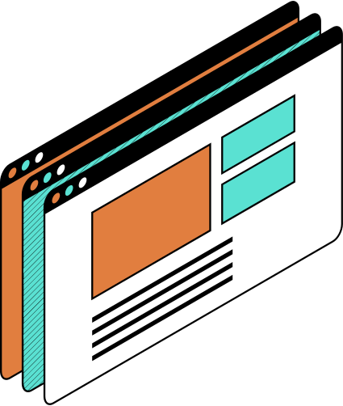

3 BILLION
More than 3 billion people are now using the Internet, according to the United Nations agency that oversees international communications.

Slide 12
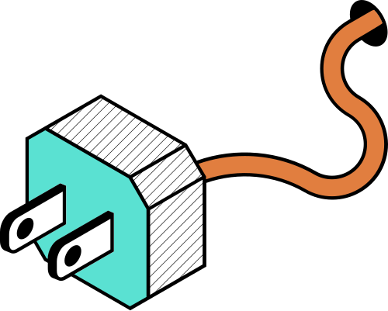
PRESENT DAY
A BRIGHT,
connected future
The internet as we know it will keep
on evolving faster than we can anticipate to meet the growing needs of its billions of users worldwide.

Slide 13


THANK
you!
for spending
your day with us

Slide 14
RESOURCE
PAGE
Use these design resources in your Canva Presentation.
This presentation template uses the following free fonts:
Titles: Oswald
Headers: Montserrat
Body Copy: IBM Plex Mono
You can find these fonts online too. Happy designing!
Don't forget to delete this page before presenting.

Slide 15

THIS PRESENTATION TEMPLATE IS FREE FOR EVERYONE TO USE THANKS TO THE FOLLOWING:
SlidesCarnival for the presentation template
Pexels for the photos
HAPPY DESIGNING!

